Slide 1
Slide set for making explanatory images
Each slide can be used to make an image to explain a key functionality of the ePosters.
These images could then be shared with delegates (perhaps on Twitter)

Slide 2
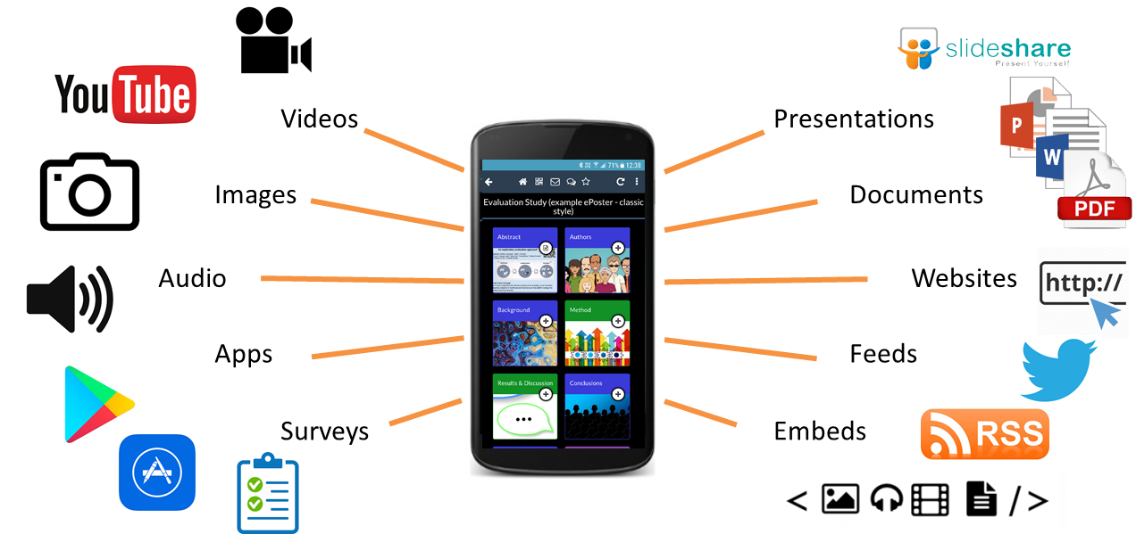
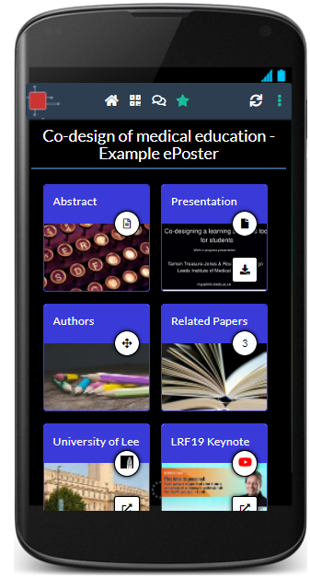
Explore the rich ePosters
Authors have been able to include great resources for you to explore such as presentations, videos, surveys, guidelines and references.
You can open and explore the ePosters from your computer, tablet or smartphone.

Slide 3
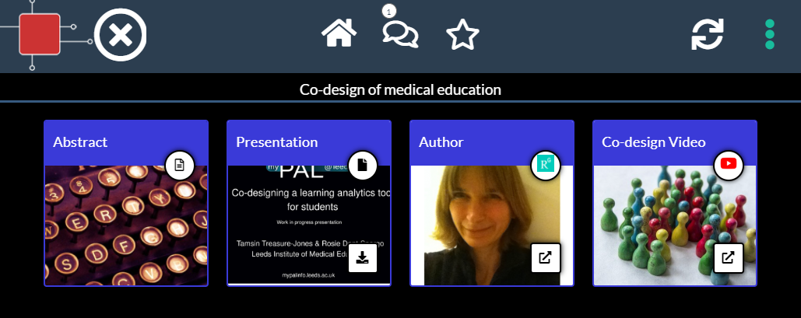
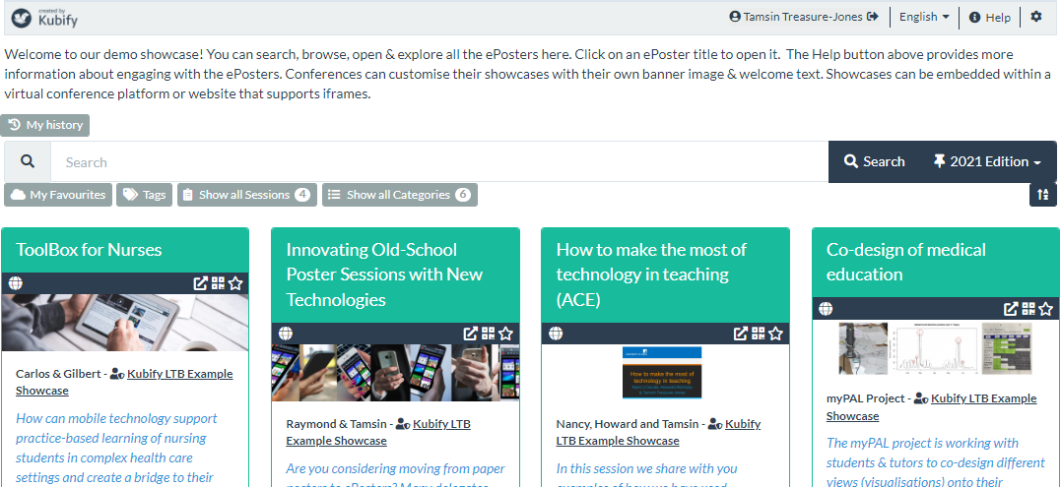
Open and explore an ePoster from the Showcase
3
1
2
Click on ePoster title to open it in the viewer
Click on any Tile to view its content
Click on the X button to close the viewer and return to the Showcase

Slide 4
Search the ePoster showcase
Browse by scrolling down the screen.
Search by typing in the search box. This searches across author, title, poster number and description fields.
Search by Tags by clicking on the Tags button and starting to type a tag name into the box that appears. Auto-suggestions will be made of any matching tags in use.
Filter the view by using one of the Session or Category filter buttons.

Slide 5
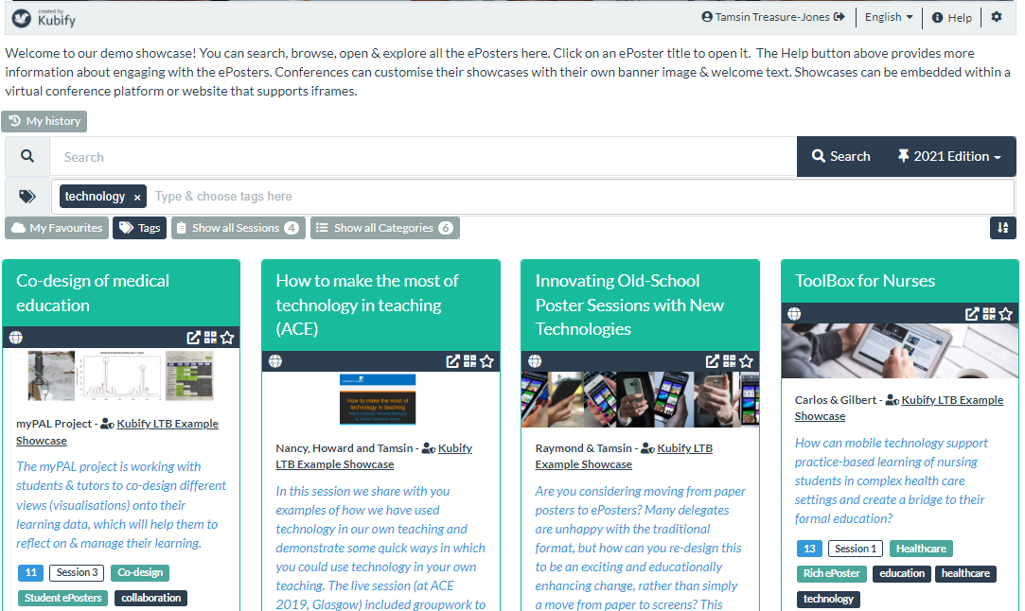
Another way to search using Tags
Click on an ePoster’s tag to see only ePosters with the same tag

Slide 6
See the full list of authors of an ePoster
Hover over the Named Author to see the full list of authors (if this has been provided)

Slide 7
Favourite (and return to) an ePoster
Favourite
Click on the star icon to favourite an ePoster
You can find your Favourites later by clicking on the More Menu and choosing My Favourites
You can also find a My Favourites button on the Showcase page
If you are signed-in then your favourites list is saved to your account.
If you are not signed-in then your favourites list is saved to your current device.

Slide 8
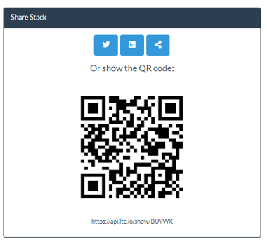
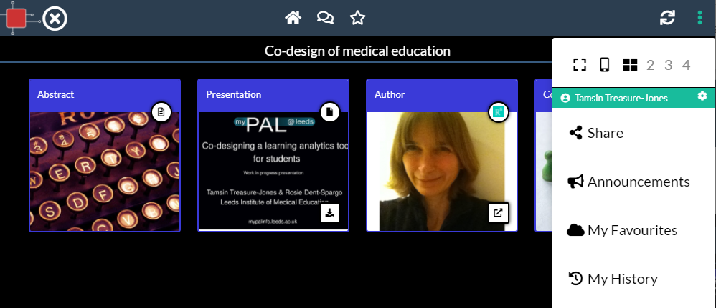
Sharing an ePoster
1
4
2
3
Click on the ePoster’s More Menu
Choose Share
Here you can see and copy the ePoster’s unique QR code and web address (weblink)
You can also share the ePoster’s weblink to Twitter or LinkedIn

Slide 9
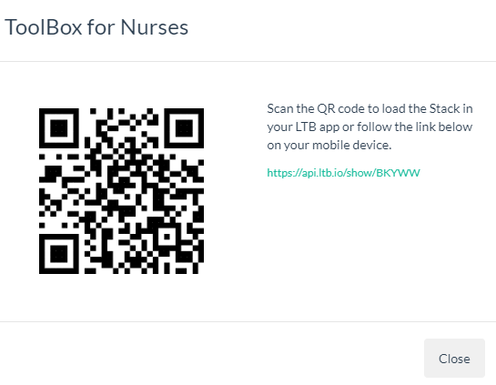
Finding an ePoster’s QR code & weblink from the showcase
3
1
2
Click on the QR icon on the ePoster in the showcase. It will open a window showing you the QR code and web address for that ePoster
You click on the QR code to download that image to share with others
You can highlight and copy the weblink to share with others

Slide 10
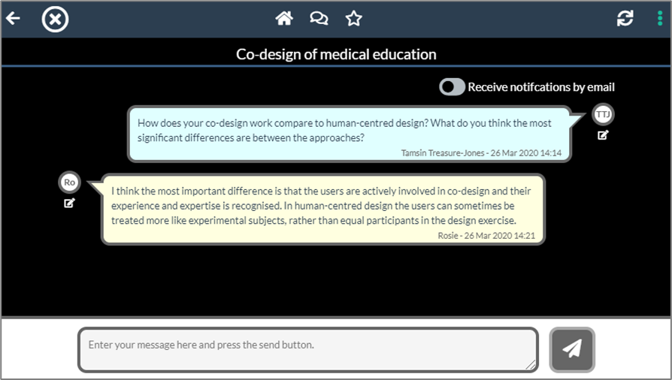
Post comments or questions on an ePoster
Chat
Click on the chat icon. Sign-in if prompted (various sign-in options offered)
You can view the public discussion
You can post questions, comments and answers
You can choose to turn on email notifications of new chat on this ePoster

Slide 11
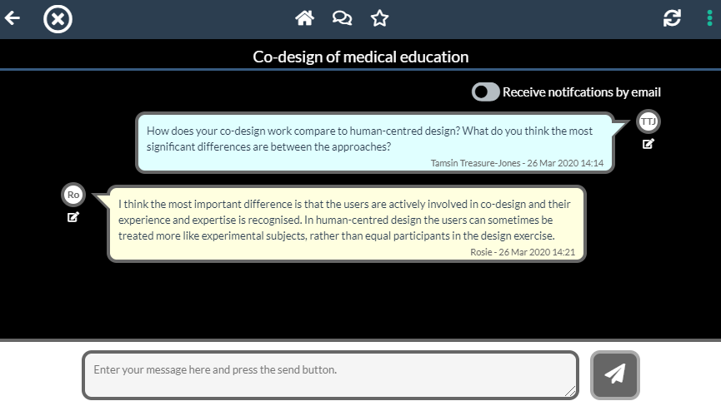
Get notifications of new chat messages
Open chat
Turn on email
notifications
Chat notifications
Open chat (sign-in when prompted, various routes offered)
Turn on email notifications
Receive emails whenever there is new chat on this ePoster

Slide 12
Benefits of signing-in
Sign-in if you want your Favourites and History to be available across devices.
Sign-in if you want to use the ePoster chat area.
You can sign-in using a wide range of social platforms or make your own free LTB account.

Slide 13
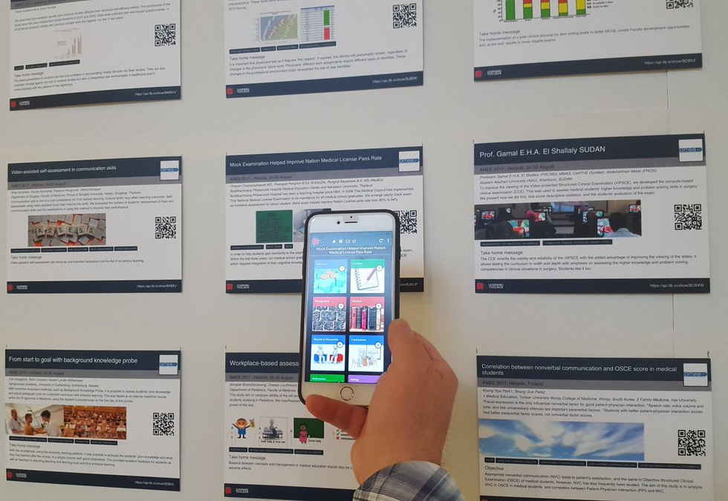
Open and explore an ePoster from the summary poster wall
ePoster
Summary poster
The summary posters provide a summary of & access to each of the ePosters.
Scan the QR code on the summary poster
to open the ePoster.

Slide 14
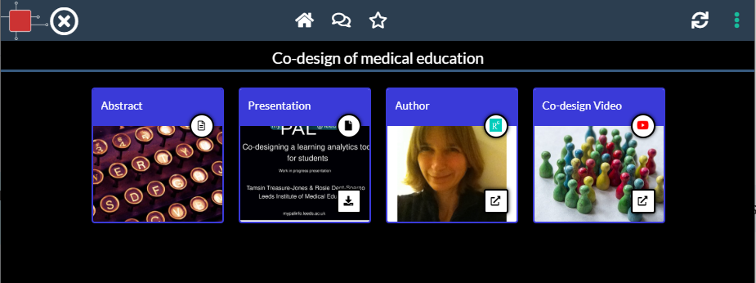
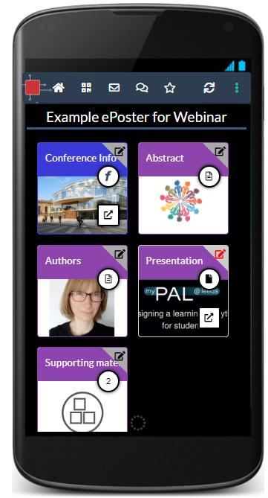
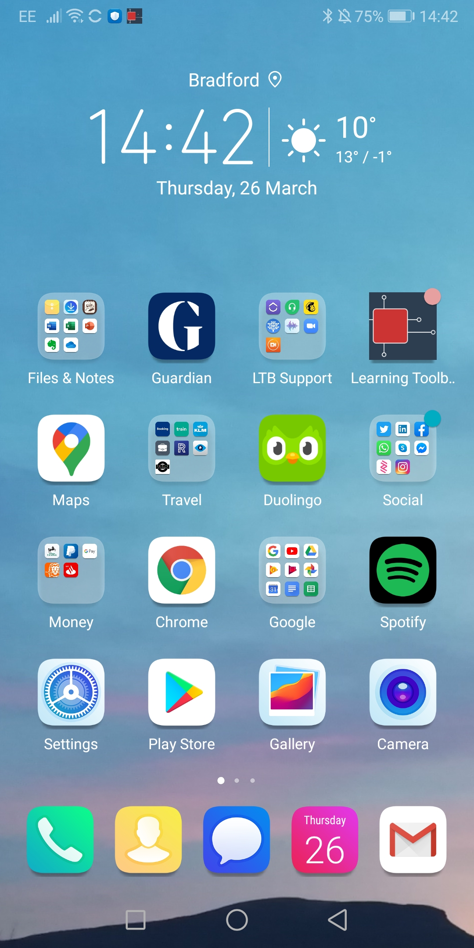
Push notifications using the Learning Toolbox App
Delegates can explore and engage with all the ePosters in the showcase.
This exploration can include using the chat to post questions and comments, and favouriting ePosters they want to follow.
Chat
Favourite
To get push notifications of new chat activity then participants should install the free Learning Toolbox app, accept notifications and sign-in.
They will then get push notifications on their phone of new chat activity on the ePosters they have favourited.
Learning Toolbox
There is new chat activity
Co-design of medical education – Example Event

Slide 15
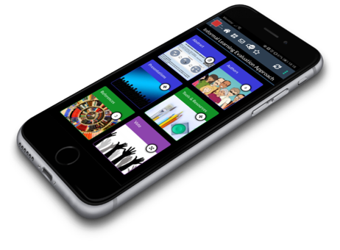
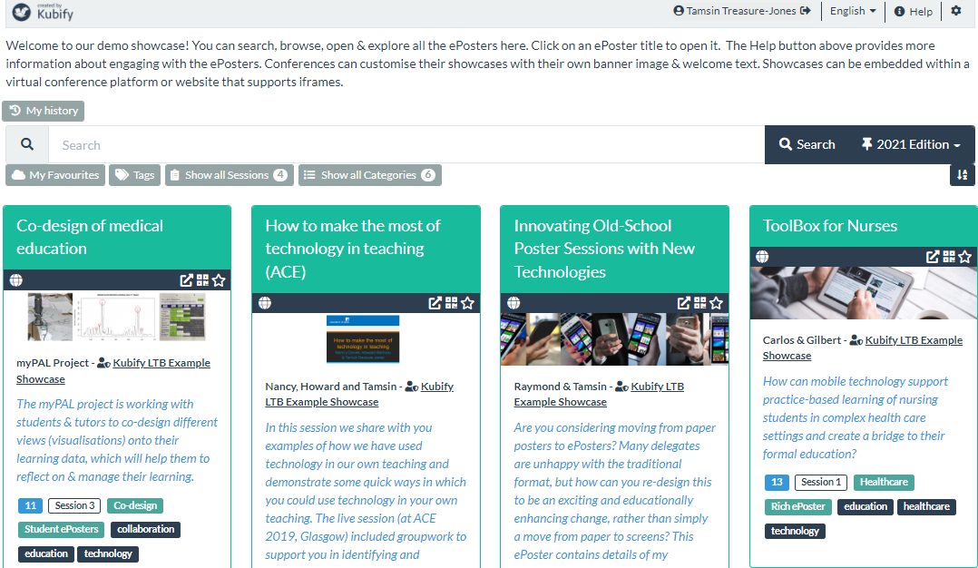
Learning Toolbox
for ePosters
For more information
Our web page: ltb.io/eposters
Contact us: info@kubify.co
This work is licensed under a Creative Commons Attribution 4.0 International License.
Attribute to “Kubify’s Learning Toolbox for ePosters” and use the link https://ltb.io/eposters
Notes:
Check web page address

