Slide 1
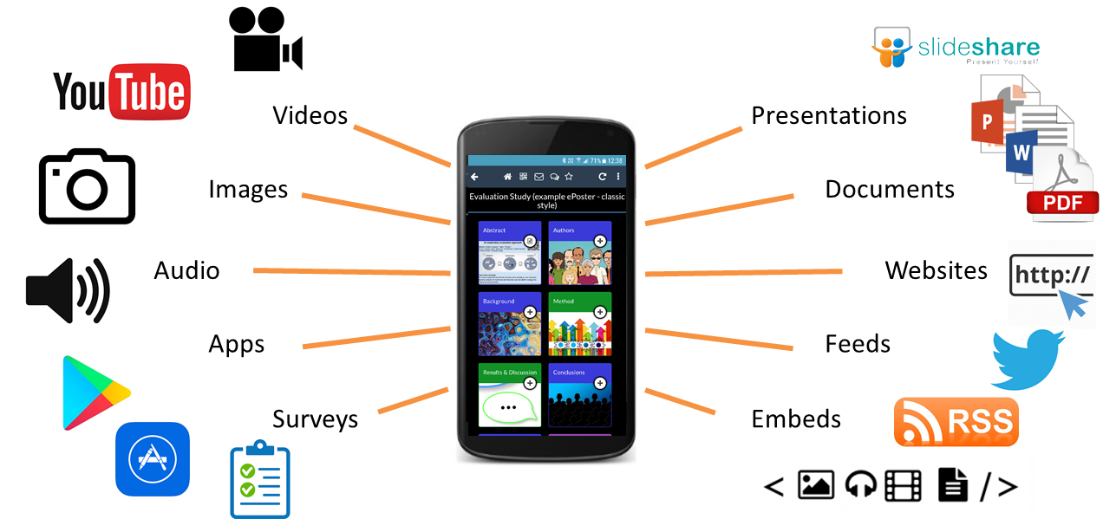
So much to explore!
Each of these summary posters links to a
wonderful, rich ePoster presenting the authors’ work.
Scan the QR code to open and explore their rich ePoster.
Authors have been able to add presentations, videos, audio, links to websites, background documents and more.
Everything you need to get a full overview of their great work.

Slide 2
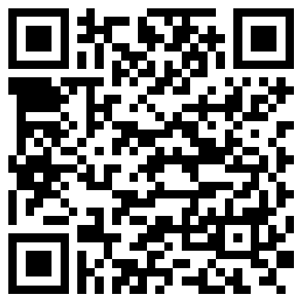
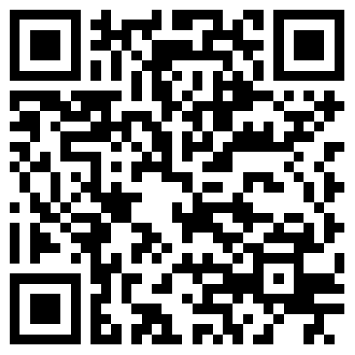
How do ePosters work?
Using the Learning Toolbox App
Get the App
Learning Toolbox is available for Android and iOS devices
Search for ‘Learning Toolbox’ in Google Play or App Store or scan one of the codes below.
Explore the ePosters
Open the Learning Toolbox App
Pick a summary poster on the wall
Scan the code to load the ePoster

Slide 3
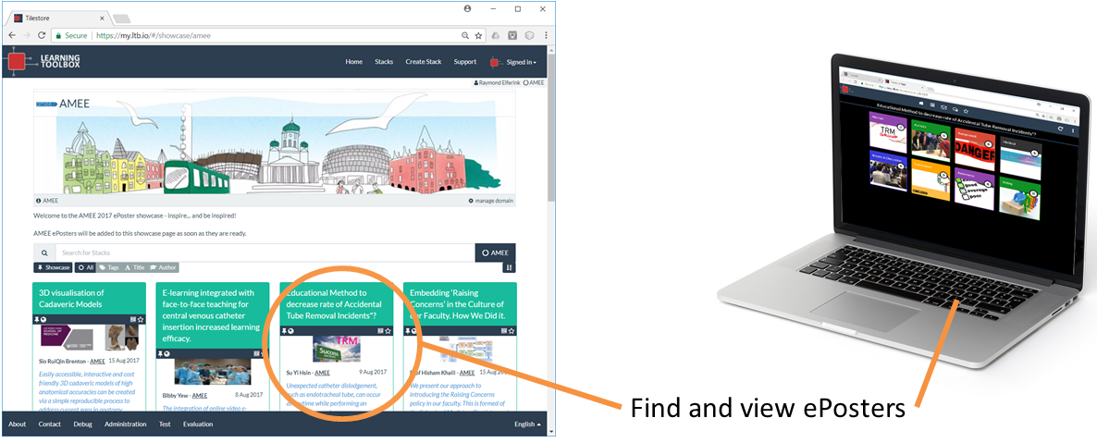
How do ePosters work?
Without the App
Explore on the web
If your device has a QR code scanner then:
Pick a summary poster on the wall
Scan the QR code to load the ePoster
If you do not have a QR code scanner then:
Pick a summary poster on the wall
Open its ePoster URL in a web browser
Go to the ePoster Showcase online:
Pick an ePoster in the showcase
Click on its title bar to open the ePoster
my.ltb.io/#/showcase/EDIT

Slide 4
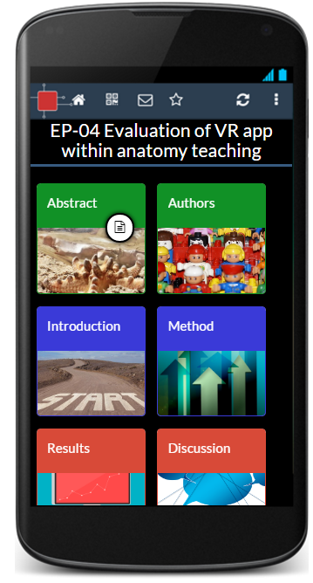
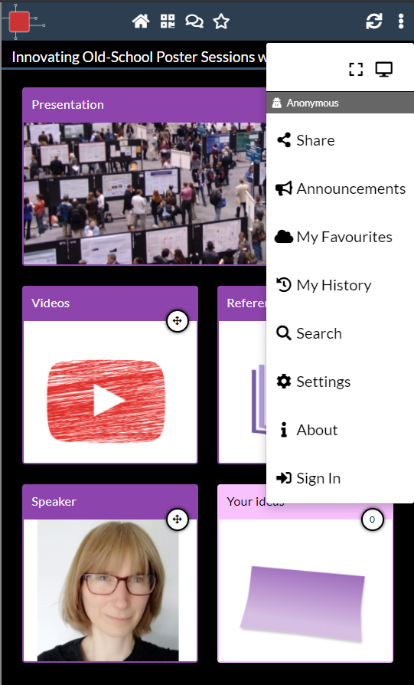
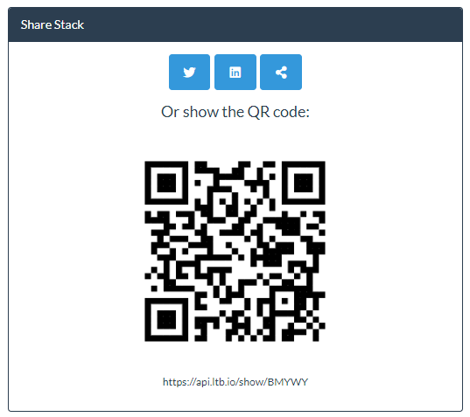
Engaging with ePosters
Chat
Sharing
Click on the More Menu
Choose Share
Show its QR code to others to scan
View any ongoing discussion
Post questions, comments and answers
Prompts you to login (via social media or create free local account)
1
2
Favourite/Subscribe
3
Click on Star to Favourite
See all your Favourites by clicking on the More Menu and choosing My Favourites
Sign-in first (from the More Menu) if you want to keep your favourites across devices

