Slide 1
ePoster Presentation – Quick Guide for Chairs
Chair’s Check
The ePoster showcase should be open onscreen
The session filter should be showing your session ID (for example Session 3)
ePoster Presentation Session Format
Each ePoster author has 4 minutes to present their ePoster
The author will find, open, present and close their ePoster
A Q&A can be held after all the presentations are finished
Choose another session filter
Current session filter
Troubleshooting for Chairs
If the showcase is not showing onscreen
Open the Chrome Browser
The ePoster showcase is set as the start and home page and will open automatically
If the session filter is wrong
Click on the Show all Sessions button and choose your session
Then click on Hide Sessions (to hide the session filter buttons)
If an ePoster author cannot find their ePoster in the session
Click on the current session filter button to turn it off
The author should then search for their ePoster using the search bar
After they have done their presentation then click on the Show all Sessions button and choose your session. Then click on Hide Sessions
ePoster Showcase
Web address is: ADD ADDRESS
It has been set as the start and home page on the Chrome browser
ePoster Helpdesk staff will make themselves known to you at the start of the session and will be nearby if you need any help.

Slide 2
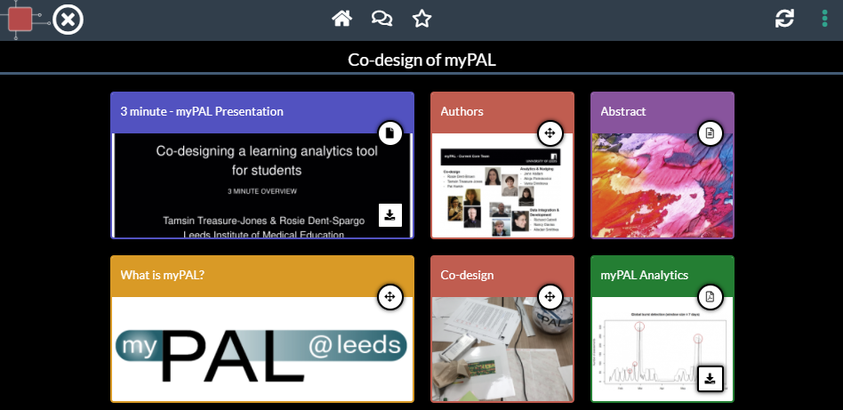
ePoster Presentation – Quick Guide for Presenters
2. Click to show Tile contents
To present your ePoster
Scroll down the showcase screen to find your ePoster
Click on your ePoster’s title bar to open the ePoster
Click on any tile to open and show its content
1. Click to open ePoster
You can choose to open a file in full screen by clicking on the full screen button.
To exit full screen click on ESC on your keyboard.
Click on the back button to return to your ePoster’s previous screen
When you have finished your whole presentation, click on X to close your ePoster
4. Close ePoster
3. Return to previous screen
Full screen button

